Slide 1
Introduction to Computation
Fan Cheng Shanghai Jiao Tong University
http://www.cs.sjtu.edu.cn/~chengfan/
chengfan@sjtu.edu.cn
Autumn, 2022

Slide 2
Outline
Basic data structure
List
Tuple

Slide 3
Data structure (数据结构)
Student id | Name | GPA | Math | Physics | Python | ….
001 | James | 3.5 | 90
002 | Ivan | 3 | 80
… | …
… | …
… | …
Suppose we have lots of data, how could we find and modify the right information efficiently?
We need to store the data in a structural manner.
In computer science, a data structure is a data organization, management and storage format that enables efficient access and modification.
More precisely, a data structure is a collection of data values, the relationships among them, and the functions or operations that can be applied to the data.
data structure = data representation + data operation (functions)

Slide 4

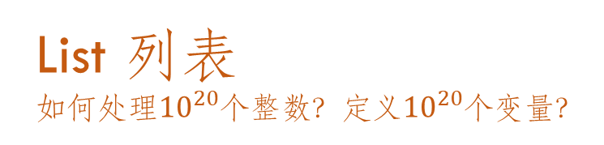
List 列表
如何处理${10}^{20}$个整数？定义${10}^{20}$个变量？

Slide 5
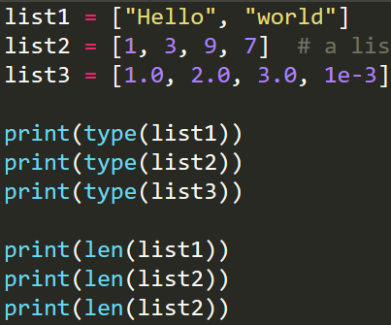
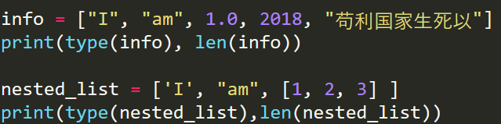
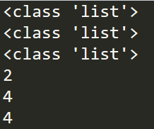



List: creation 创建
A list is an ordered set of values, where each value is identified by an index
Enclose the set of elements in square brackets [], separated by “,”
list1 = [“Hello”, “world”] # a list with two string
list2 = [1, 3, 9, 7] # a list with four integers
list3 = [1.0, 2.0, 3.0, 1e-3] # a list with four floats
The elements of a list don’t have to be the same type
A list within another list is called to be nested (嵌套)
Recall: assignment statement (=) can create a variable
type() could be used to determine the type of list1, list2, list3
len() could be used to determine the length of a list, like list1, list2, list3
严格按照语法：[,,,,,,,,], 不是{,,,,,,}, 也不是[;;;;;]。[],(),{} are different
Mixed list and nested list

Slide 6
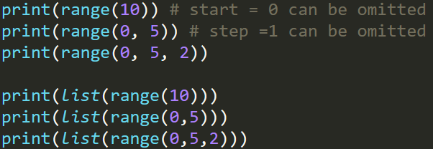
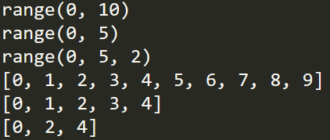
List: list()
The type of a list is “list”. Python provides a built-in type conversion function called list() that tries to turn whatever you give it into a list.
list() is called the constructor (构造函数，每个类型都有自己的构造函数)
Pass string to list() will split the string to list form
List with range(). range(start, stop, step) returns a sequence from start to stop with step
When start = 0, start can be omitted
When step = 1, step can be omitted
https://docs.python.org/3/library/stdtypes.html#range
Together with list(), it generates a list from start to stop with step

Slide 7


List: access 访问
Elements in the list (a) are ordered starting from 0, 1, …, len(a)-1
To access the i-th element of a list: a[i]
If i exceeds the max length of a, there will be an error
If an index has a negative value, it counts backward from the end of the list
a[-1] is the last element of list a (可以看作 mod len(a))
世界上最常见的错误: out of range

Slide 8
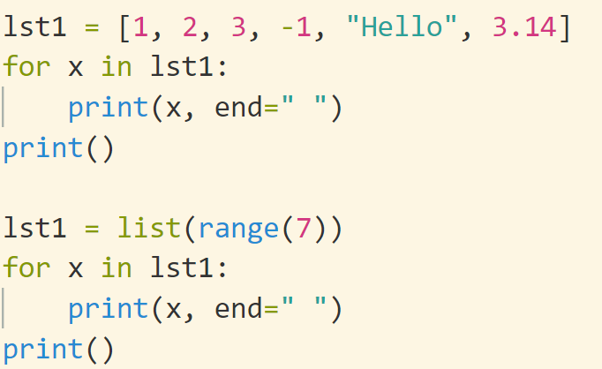

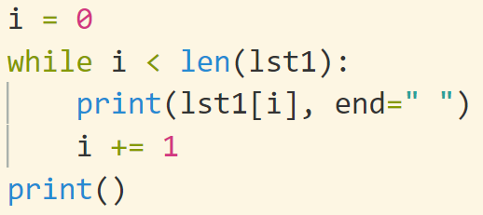
for
for x in collection_a:
do_sth()
#The type of collection_a could be list, tuple, dict, string, set, etc.

Slide 9
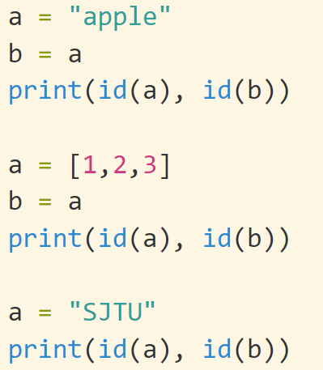
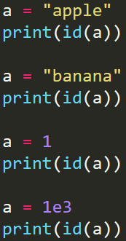
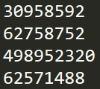
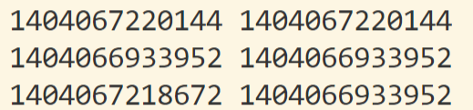
Data model 数据模型
Recall: Every variable points to a memory location in python. The location is referred to as id of the variable.
Every variable x in python has an id. Function id(x) returns the id of x.
id(x): 变量x所指向的数据的地址
When variable is reassigned, the location (id) will be different
https://docs.python.org/3/library/functions.html#id
 | a | p | p | l | e
 | b | a | n | a | n | a
 |  |  | 1
 |  | 1 | 0 | 0 | 0
赋值语句x=y中，x和y会指向同一块内存区域，具有相同的id。
如果x的类型可以修改，那么修改y相当于修改x。

Slide 10
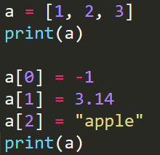
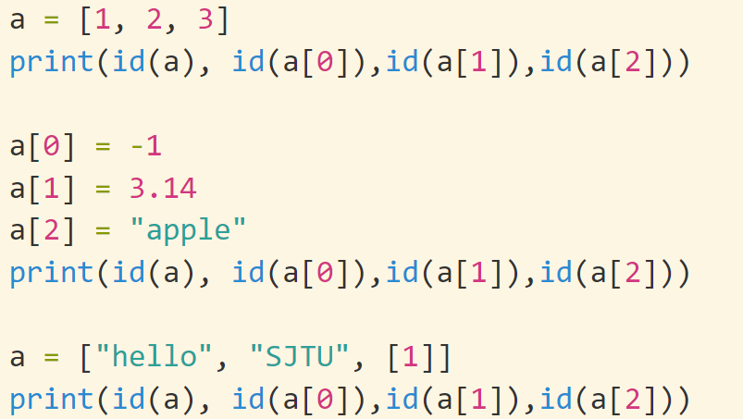
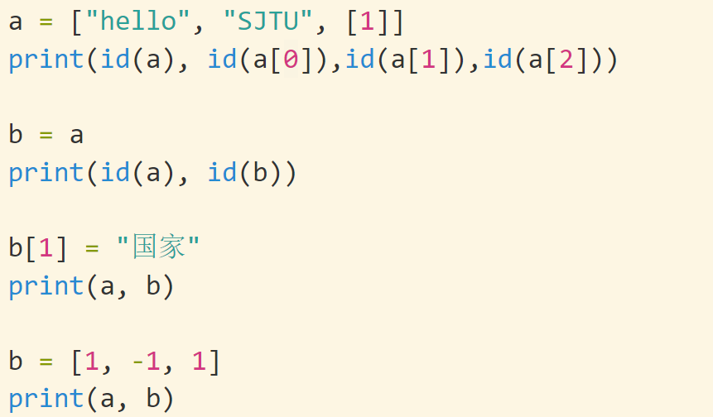

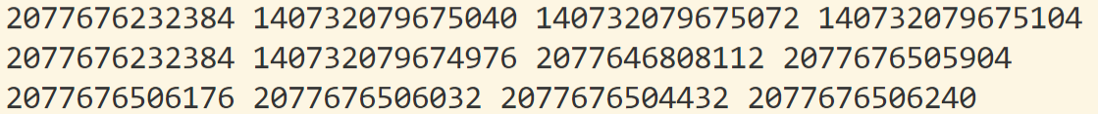
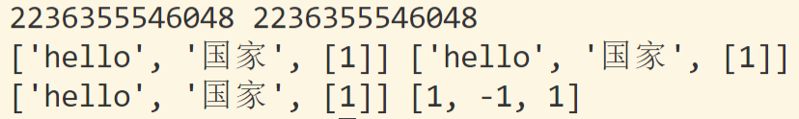
List: modification
Assignment statement could be used to modify the elements of a list
list[i] = new_element
List is mutable (可修改的) . However, in some situation, the id remains unchanged. That is, the content of the list is changed, not its location
List可修改，重新赋值和修改差别很大
数据是否可以被修改是一个关键因素

Slide 11
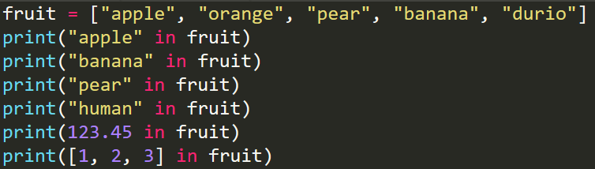

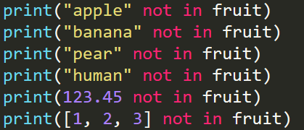

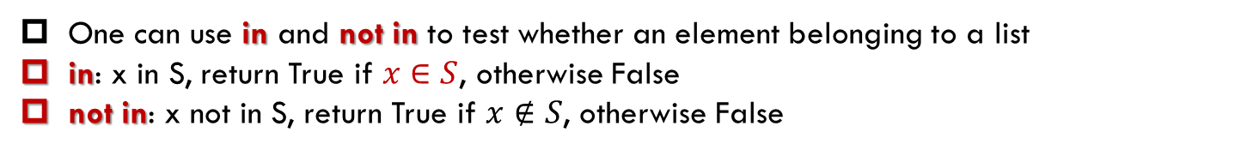
List: membership
One can use in and not in to test whether an element belonging to a list
in: x in S, return True if $x∈S$, otherwise False
not in: x not in S, return True if $x∉S$, otherwise False
in 和 not in是关键字

Slide 12
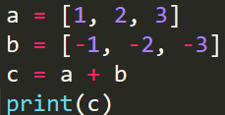




List: +, *
+: a+b will concatenate two lists a and b
*: a*n will repeat a list a given number of times: n

Slide 13
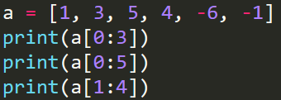


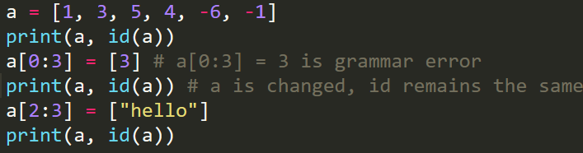


List: slice (切片)
Given a list list_a, you could get a slice of list_a via: list_a[i:j], it is the sub-list of list_a[i], list_[i+1], …, list_a[j-1]. (list_a[j] is not included!)
The type of list_a[i:j] is still list
id(a[0:4]) $≠$id(a)
In default, the slice is started from 0 and ended till the end of the list
a[0:3] is identical to a[:3] (0 can be omitted)
a[2:6] is identical to a[2:] (6 can be omitted)
a[0:6] is identical to a[:] (Both 0 and 6 can be omitted)
With the slice operator we can update several elements at once
We can also remove elements from a list by assigning the empty list to the slice

Slide 14
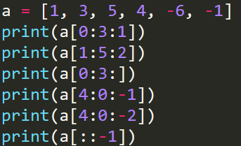
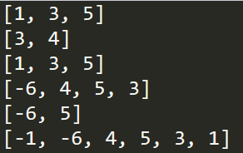
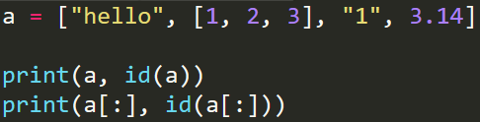

List: slice with step
Another usage of list slice is to set the step size from the start to the stop:
a[start: stop: step]
We get the slice a[start], a[start+step], ….
When step =1, step can be skipped. step could be negative
a[::-1] returns the inverse of a
range()里面也可以省略
stop is not included!
a and a[:] are not in the same address, but they have identical elements

Slide 15
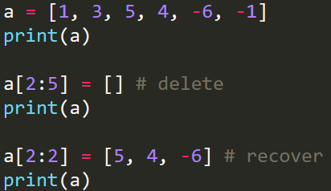

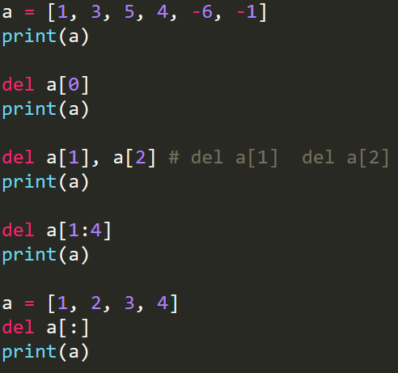
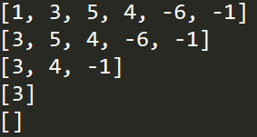
List: slice (cont’d)
We can remove elements from a list by assigning the empty list to the slice
We can add elements to a list by squeezing them into an empty slice at the desired location
Python provides an alternative operation del that is more readable
How about del a?

Slide 16
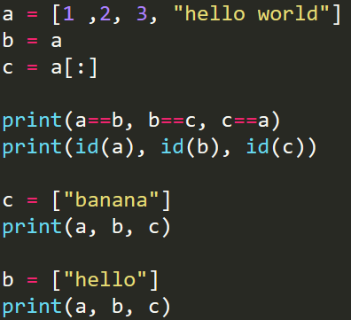
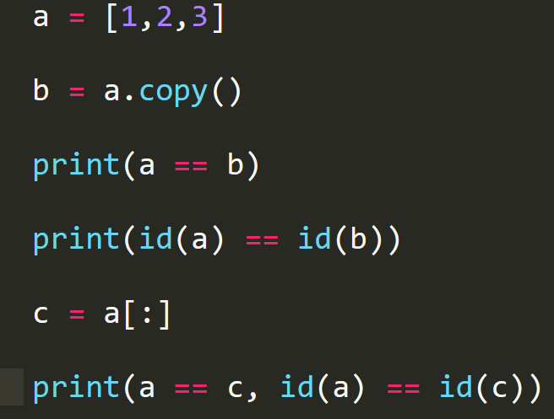
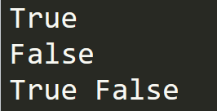
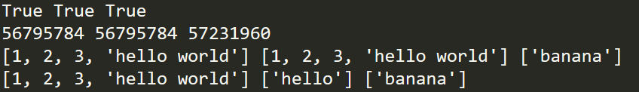
List: cloning
If we want to modify a list and keep a copy of the original, we need to be able to make a copy of the list itself
This process is sometimes called cloning (克隆)
The easiest way to clone a list is to use the slice operator: newlist = list[:]
newlist = list.copy()
思考：List 中，何时是生成新的，何时是直接修改？

Slide 17
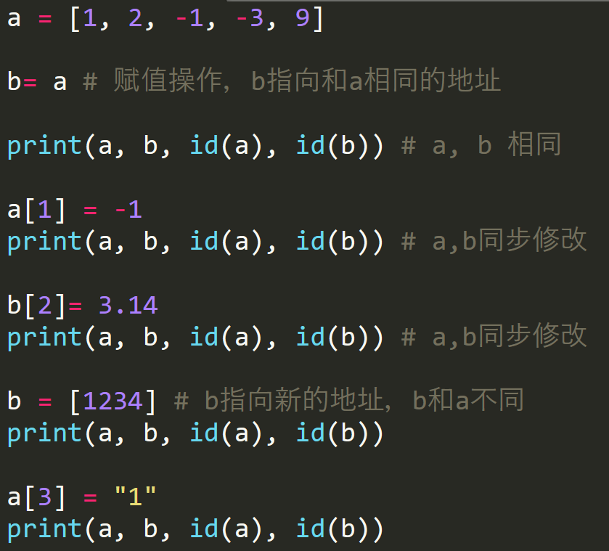
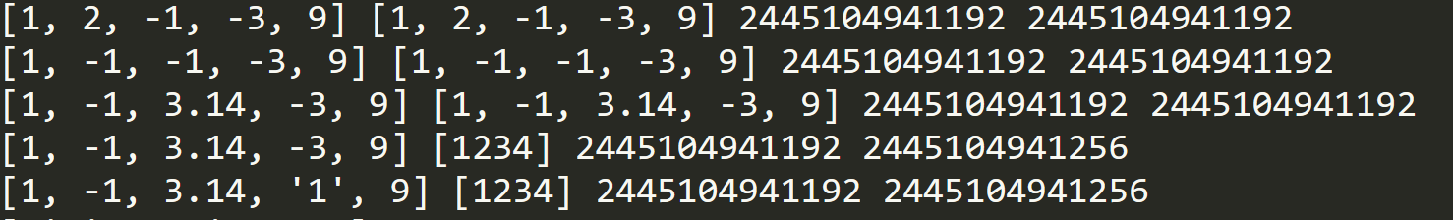
新建 Vs. 修改
非常非常容易出错

Slide 18
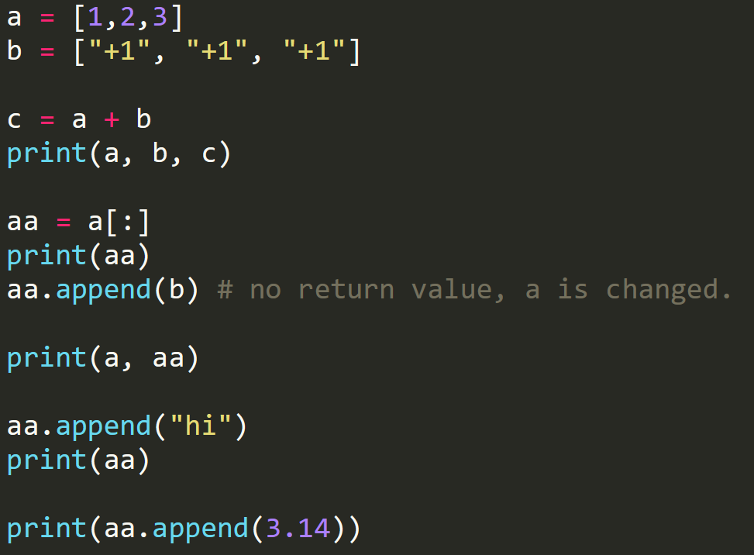
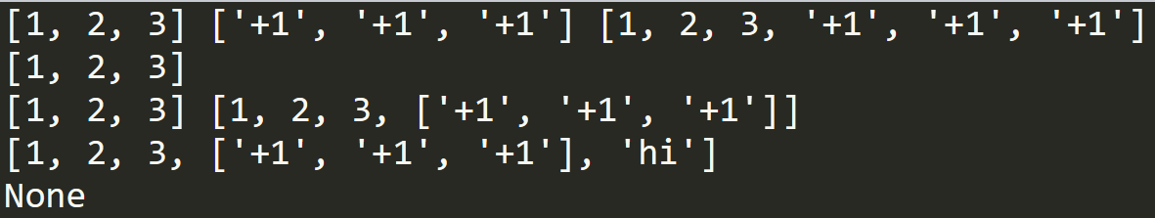
append() 追加、添加
The append() method appends an element to the end of the list itself
No return 没有返回值
The list itself will be changed
最最最常见错误
a=a.append(x)

Slide 19
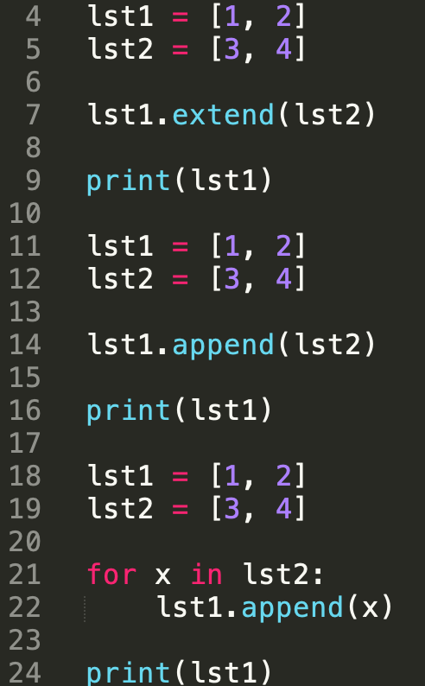
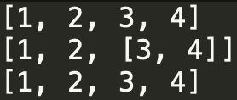
extend() 扩展
The extend() method adds all the elements of an iterable (list, tuple, string etc.) to the end of the list.
The same with append(). No return. Modified in place. 没有返回值
辨析extend和append的区别

Slide 20
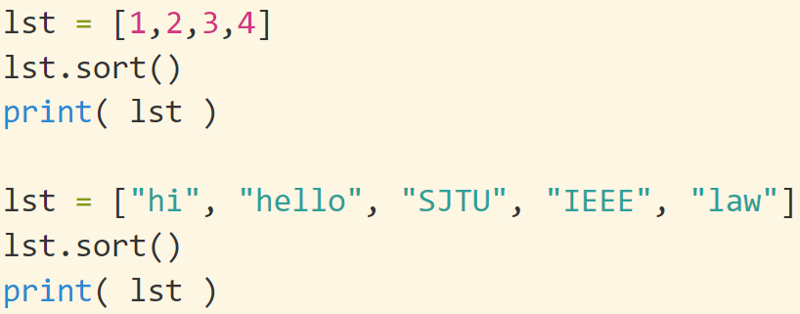
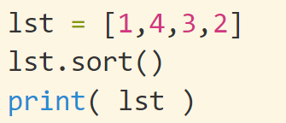
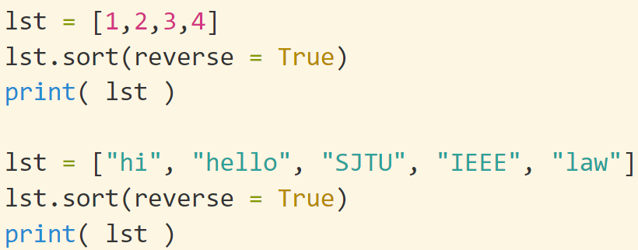

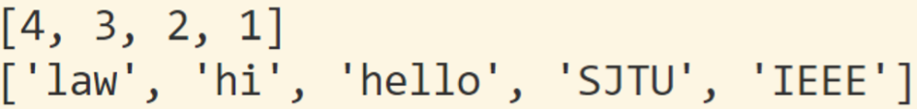
sort() 排序
The sort() method will sort the list by ascending order. 按照从小到大排序
list.sort() has no return value
The elements should be the same type
Parameters
reverse Optional. reverse=True will sort the list descending. Default is reverse=False
key Optional. A function to specify the sorting criteria(s)

Slide 21
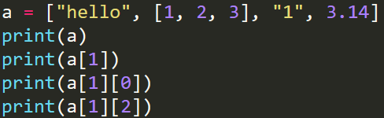
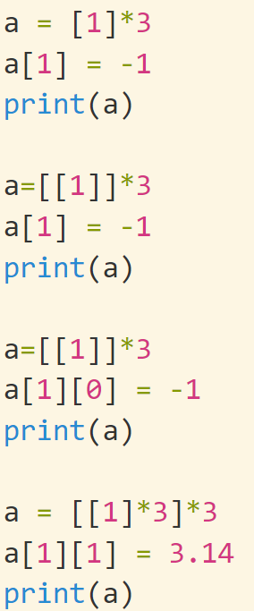
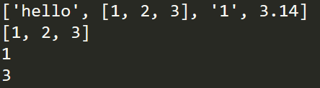

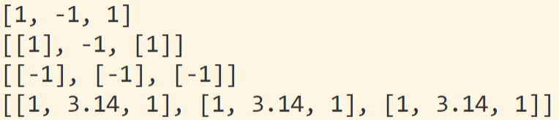
Nested list
A list can contain another list as its element: a=[…, […], …]
To access the inside list, a[i][j]
One way to create a matrix: matrix = [[1, 2, 3], [4, 5, 6], [7, 8, 9]] (Not recommended)
思考题：写出如下程序的运行结果

Slide 22
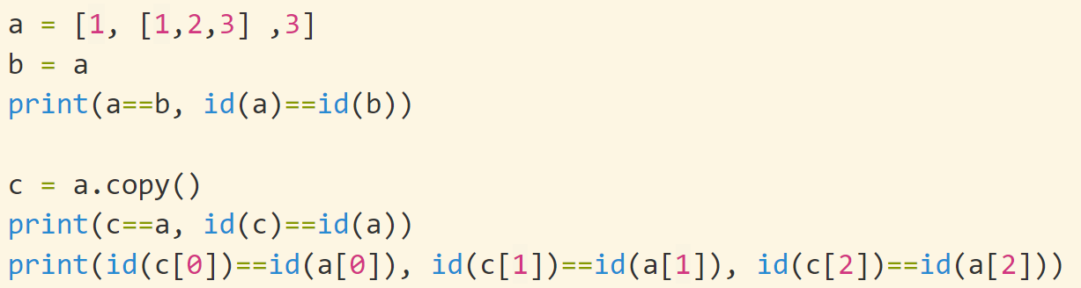
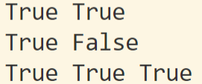
思考题：为什么a和c的id不一样，但是它们的每个元素的id一样
每个元素保存的是id
 | 1
 |  |  |  |  | 1 | 1 | 1
 | e | e | e
 |  |  |  | b | b | b
“=”: 重新赋值 or 修改
[1,1,1]
e=[1]
b=[1,1,1]

Slide 23
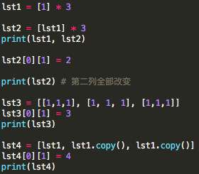



Nested list
后代的后代的后代可能是同一个人
Nested list非常非常非常容易出错：地址的地址的地址……可能是同一个内存区域
a.copy() 对于单层list
deepcopy() 对于nested list (https://docs.python.org/3/library/copy.html)
注意：list某些地方
保存的 （地址的地址）
copy()的时候，虽然a 和 b指向不同的内存块，但是这两个内存块保存了相同的内容。所以对于嵌套的list，两次下标操作[][]，修改b也就修改了a
deepcopy会把内容全部复制一遍，无论有多少层地址 (所有的后代都会被复制)

Slide 24


List: Remove an Item
Remove an item from a list in Python (clear, pop, remove, del)
Remove all items: clear()
Remove an item by index and get its value: pop(index=-1)
In default, the last element
Remove an item by value: remove(value)
Remove the first element that matches the value
Remove items by index or slice: del
Remove multiple items that meet the condition: List comprehensions.

Slide 25

List: count() method
count() returns the count of how many times a given item occurs in a List.
list_name.count(object)

Slide 26


List comprehension (列表推导)
List是python的核心
Now we will introduce a simple alternative to create a list of squares
Grammar
单重循环 [expression for target in iterable if conditon]
多重循环 [expression for target1 in iterable1 if condition1
for target2 in iterable2 if condition2 ..
for targetN in iterableN if conditionN]
A list comprehension consists of brackets [ ] containing an expression followed by a for clause, then zero or more for or if clauses
The result will be a new list resulting from evaluating the expression in the context of the for and if clauses which follow it
List comprehension can be nested
Pythonic

Slide 27


if
嵌套
函数
如何创建新的list
for
list comprehension
[0]*n
List(range()), list(set), list(str)
推荐List Comprehension
根据需要合理使用
清晰，可读，正确
比for更快
Pythonic

Slide 28





List: 删除
列表删除一个元素后，会改变后面元素的序号，特别容易出错
a[2]是原来的”a[3]”
尽可能不要删除一个列表中间的元素
列表在内存中是顺序排列的，删除后要重新恢复，速度慢
标记为不存在的元素：例如-1，或者None

Slide 29


尽可能不要循环动态删除一个数据结构，很容易出bug，特别清醒

Slide 30


多用切片，快
大概相差一个数量级

Slide 31
Quick Test
Given two strings: str1 = “Hello World”, str2 = “Machine Learning”
Create two lists list1and list2, from str1 and str2, respectively
Reverse list2
Print the characters of list1 at the even positions
Concatenate list1 and list2
Repeat list1 3 times and list2 twice
How to extract a list from a string, e.g., “[1,2,3,-1,-5, [1,2,3]]” to [1,2,3,-1,-5, [1,2,3]]

Slide 32






Tuple (元组)
A tuple is a collection which is ordered and immutable(不可变). In Python tuples are written with round brackets () (the round brackets can be omitted)
tuple_a = (element1, elmement2, …, )
To create a tuple with a single element, we need to add a “,” at the end
tuple_a = (element1,)
Tuple and list are all ordered. Tuple is unchangeable while list is not
len() and type() also work for tuple
[] are the same for tuple and list
Memberships (in and not in) are the same
for x in tuple_a:
元组：不可修改的list

Slide 33



Tuple: more functions
tuple() method will make a tuple (similar to list()) (tuple类型的构造函数)
tuple_a.count(x): Returns the number of times a specified value occurs in a tuple
tuple_a.index(x): Searches the tuple for a specified value and returns the position of where it was found
When x is not in tuple_a, an error will arise
In python, list and tuple are classes. In the above example, a is an object of class tuple. Both count() and search() are functions of class tuple, and objects of class tuple can call these functions via “.”: object_name.function()
Will talk about class later

Slide 34








Tuple: unchangeable
When you modify tuple in program, there will be a grammar error. Include del
+, * still works for tuple since we don’t modify a tuple but create one!
Simultaneous assignment is based on Tuple：a, b = 2, 3
The left and the right should have the same number of elements

Slide 35






Tuple: packing and unpacking
Packing: serval variables can be grouped into a tuple
x = a, b, c, d # x will be a tuple with four elements
Unpacking: a tuple can be broken up into several elements
x1, x2, x3, x4 = x # Then x1 = a, x2=b, x3 =c, x4 =d
The left and right should have the same number of elements
1. 函数中同时return 多个值可以用tuple:
def f():
……
return x, y, z
x, y, z = f() # 非常常见
2. 同步赋值：x, y, z = a, b, c可以用先packing后unpacking来解读顺序

Slide 36


List VS. Tuple
List可修改，Tuple不可修改
某些操作，list是直接修改，而tuple是创建一个新的

Slide 37
Quick test
Given a tuple a = (1,2,3)
What is the result of a[0] = -1?
What is print(a[2:1:-1])
x, y, z = a, what are x, y and z?
a=1与a=(1,)的差异

